Slide 1
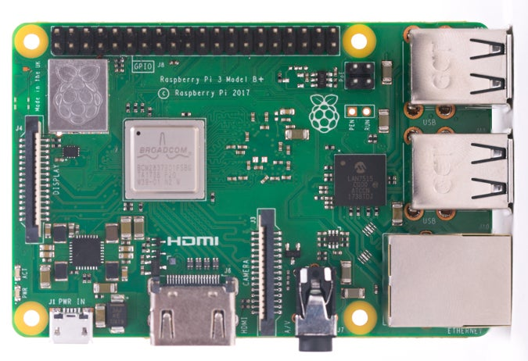
LCD Screen
Raspberry Pi
Enter Passcode:
__ __ __ __
Button 1
Button 2
Button 3

